Slide 1
Object Oriented Programming
Simple Class & Objects

Slide 2
Concepts
Class
Object
Attributes and Operations
Accessing Class Fields and Methods
Public , Private , Protected
Class and Instance variables & functions
Primitive Type vs Object/Reference Type
Static vs Non-Static
Arrays of Primitive & Object type

Slide 3
Class & Object
A CLASS is a template (specification, blueprint) for a collection of objects that share a common set of attributes and operations.
A Class is a blueprint or prototype from which objects are created
Object is an instance of a Class that is Instantiated/created with new operator in java/C#/VC.
http://docs.oracle.com/javase/tutorial/java/index.html

Slide 4
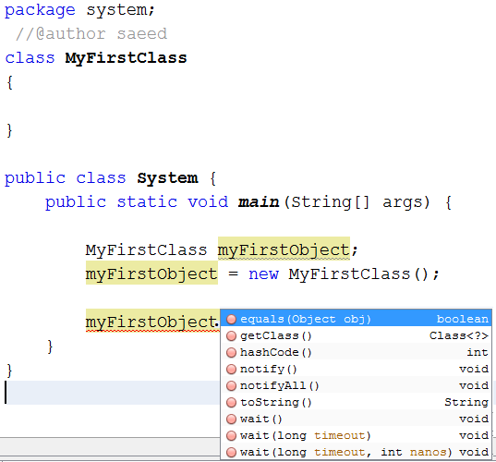
MyFirstClass
Empty Class contains nothing but it is still derived from Object Class by default in java

Slide 5
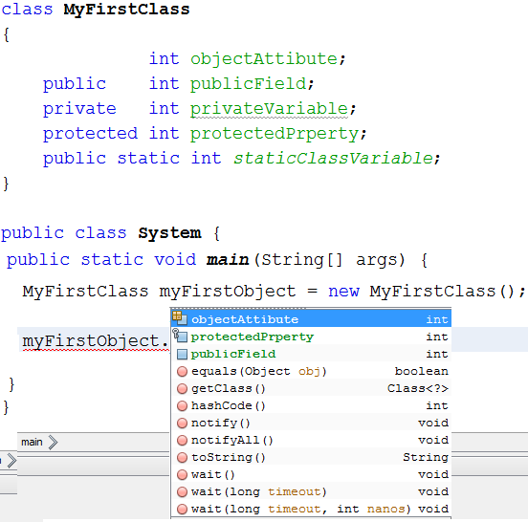
MyFirstClass
objectAttibute; +publicField:int -privateVariable:int #protectedPrperty:int +staticClassVariable:int
Instance/Object Variable
Class Variables

Slide 6
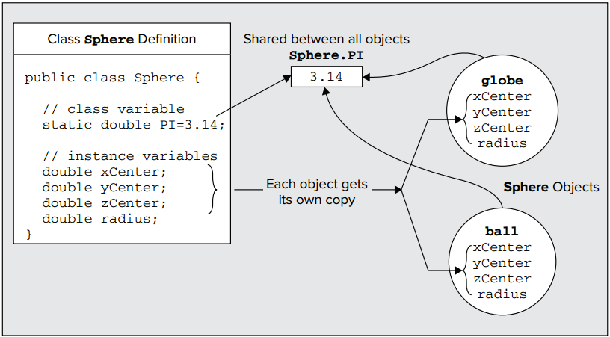
Another Example

Slide 7
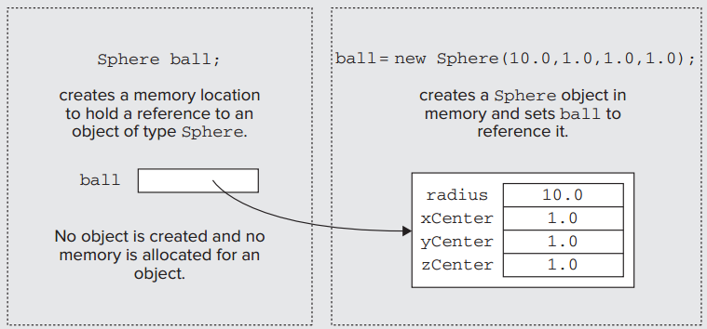
Declaration vs Definition

Slide 8
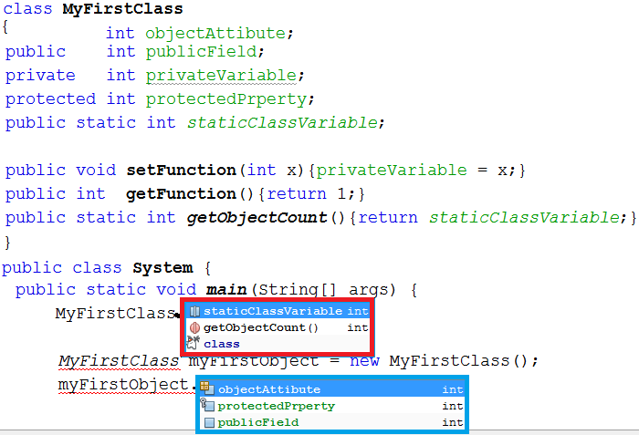
MyFirstClass
objectAttibute; +publicField:int -privateVariable:int #protectedPrperty:int +staticClassVariable:int
+setFunction(int x) +getFunction():int +getObjectCount():int

Slide 9
Access Attributes
ATTRIBUTE | PERMITTED ACCESS
No access attribute | From methods in any class in the same package.
Public | From methods in any class anywhere as long as the class has been declared as public.
Private | Accessible only from methods inside the class. No access from outside the class at all.
Protected | From methods in any class in the same package and from any subclass anywhere.

Slide 10
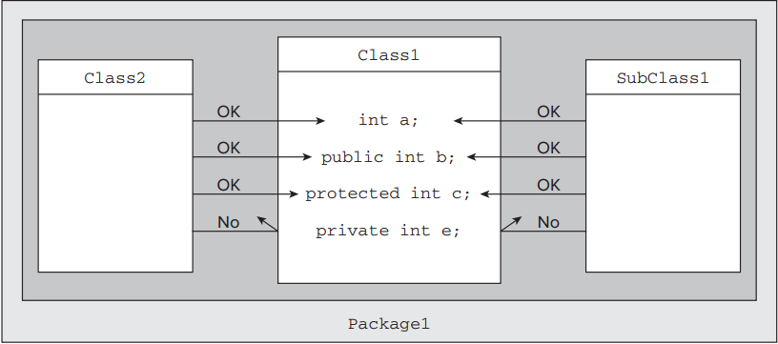
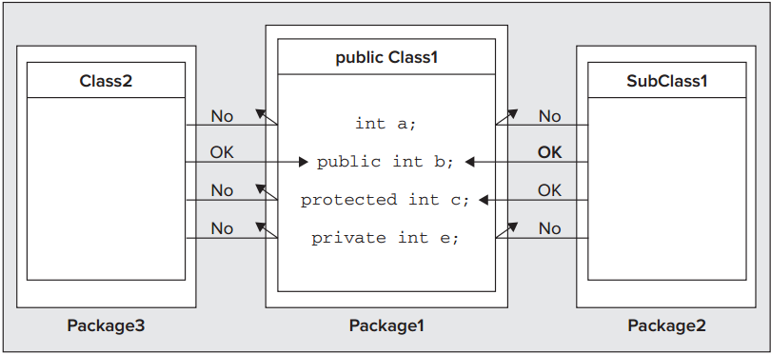

Slide 11
Summary
Concept | Definition
Class | A class deﬁnition speciﬁes the variables and methods that are members of the class.
Class Variables | Class variables are declared using the keyword static, and one instance of each class variable is shared among all objects of a class.
Instance Variables | Each object of a class has its own instance variables — these are variables declared in the class without using the keyword static.
Static Methods | Methods that are speciﬁed as static can be called even if no class objects exist, but a static method cannot refer to instance variables
Non-Static Methods | Methods that are not speciﬁed as static can access any of the variables in the class directly.
Class Member Access | Access to members of a class is determined by the access attributes that are speciﬁed for each of them. These can be public, private, protected, or nothing at all.

Slide 12
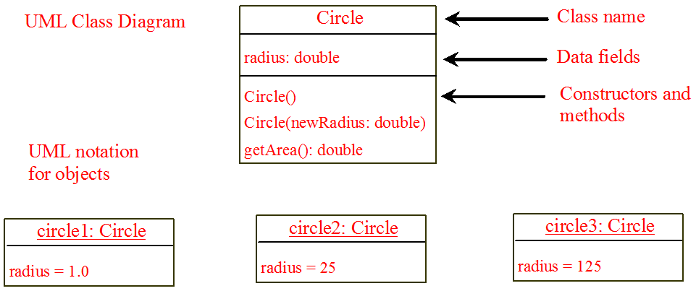
Another Example

Slide 14
Calling Overloaded Constructor

Slide 15
The this Keyword
The this keyword is the name of a reference that refers to an object itself. One common use of the this keyword is reference a class’s hidden data fields.
Another common use of the this keyword to enable a constructor to invoke another constructor of the same class.

Slide 16
Reference the Hidden Data Fields

Slide 17
Primitive vs Object type

Slide 18
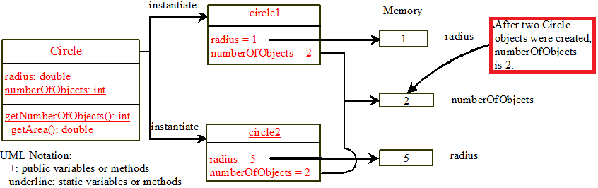
Static vs Non-Static

Slide 19
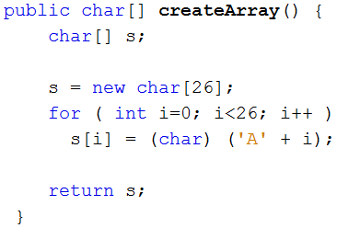
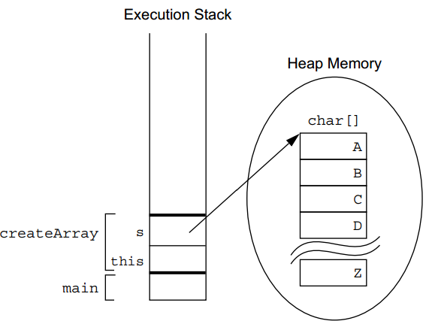
Arrays – primitive data type

Slide 20
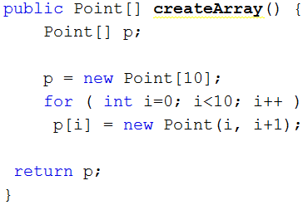
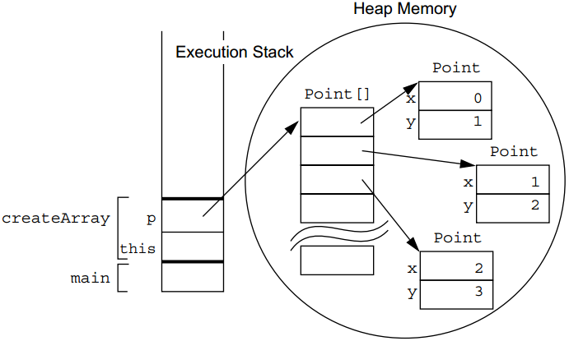
Arrays of Class Objects

Slide 21
Immutable Objects and Classes
If the contents of an object cannot be changed once the object is created, the object is called an immutable object and its class is called an immutable class. If you delete the set method in the Circle class in the preceding example, the class would be immutable because radius is private and cannot be changed without a set method.
A class with all private data fields and without mutators is not necessarily immutable. For example, the following class Student has all private data fields and no mutators, but it is mutable.

Slide 22
Example
public class BirthDate { private int year; private int month; private int day; public BirthDate(int newYear, int newMonth, int newDay) { year = newYear; month = newMonth; day = newDay; } public void setYear(int newYear) { year = newYear; } }
public class Student { private int id; private BirthDate birthDate; public Student(int ssn, int year, int month, int day) { id = ssn; birthDate = new BirthDate(year, month, day); } public int getId() { return id; } public BirthDate getBirthDate() { return birthDate; } }
public class Test { public static void main(String[] args) { Student student = new Student(111223333, 1970, 5, 3); BirthDate date = student.getBirthDate(); date.setYear(2010); // Now the student birth year is changed! } }

Slide 23
What Class is Immutable?
For a class to be immutable, it must mark all data fields private and provide no mutator methods and no accessor methods that would return a reference to a mutable data field object.

Slide 24
Scope of Variables
The scope of instance and static variables is the entire class. They can be declared anywhere inside a class.
The scope of a local variable starts from its declaration and continues to the end of the block that contains the variable. A local variable must be initialized explicitly before it can be used.

Slide 25
Class Abstraction and Encapsulation
Class abstraction means to separate class implementation from the use of the class. The creator of the class provides a description of the class and let the user know how the class can be used. The user of the class does not need to know how the class is implemented. The detail of implementation is encapsulated and hidden from the user.

Slide 26
Example: The Course Class

Slide 27
Rectangle Class
Design a class named Rectangle to represent a rectangle. The class contains:
■ Two double data fields named width and height that specify the width and
height of the rectangle. The default values are 1 for both width and height.
■ A no-arg constructor that creates a default rectangle.
■ A constructor that creates a rectangle with the specified width and height.
■ A method named getArea() that returns the area of this rectangle.
■ A method named getPerimeter() that returns the perimeter.
Draw the UML diagram for the class and then implement the class. Write a test program that creates two Rectangle objects—one with width 4 and height 40 and the other with width 3.5 and height 35.9. Display the width, height, area, and perimeter of each rectangle in this order.

Slide 28
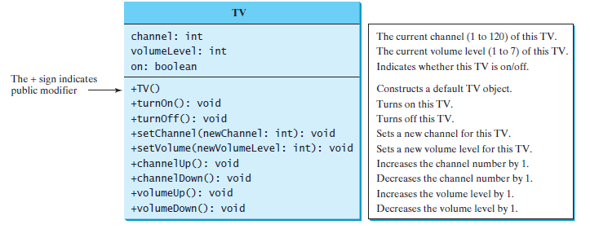
TV Class

Slide 29
Fan Class
Design a class named Fan to represent a fan. The class contains:
■ Three constants named SLOW, MEDIUM, and FAST with the values 1, 2, and 3 to denote the fan speed.
A private int data field named speed that specifies the speed of the fan (the default is SLOW).
■ A private boolean data field named on that specifies whether the fan is on (the default is false).
■ A private double data field named radius that specifies the radius of the fan (the default is 5).
■ A string data field named color that specifies the color of the fan (the default is blue).
■ The accessor and mutator methods for all four data fields.
■ A no-arg constructor that creates a default fan.
■ A method named toString() that returns a string description for the fan. If the fan is on, the method returns the fan speed, color, and radius in one combined string. If the fan is not on, the method returns the fan color and radius along with the string “fan is off” in one combined string.
Draw the UML diagram for the class and then implement the class. Write a test program that creates two Fan objects. Assign maximum speed, radius 10, color yellow, and turn it on to the first object. Assign medium speed, radius 5, color blue, and turn it off to the second object. Display the objects by invoking their toString method.

Slide 30
Problem
Create Class → Customer
Class Contains → two fields
Name represent the customer name (read-write)
Balance, representing the amount owed (read only)
Two methods
RecordPayment(), which is called to indicate that the customer has paid a certain amount of their bill.
public void RecordPayment (decimal amountpaid) { }
RecordCall(), which is called when the customer has made a phone call. It work out the cost of call and adds it to that customer’s balance.

Slide 31
Problem Cont…
Two types of calls: Calls to landlines & Calls to other mobiles and each of these are charged at a flat rate of Rs 0.5 / min for landlines and Rs 1 / min for other mobiles.
Public void RecordCall (TypeOfCall callType, int Min)

Slide 32
Enumerations
An Enumerations is a user defined integer type.
When we declare an enumerations, we specify a set of acceptable values that instances of that enumeration can contain.
enum TypeOfCall
{
CallToMobile,
CallToLandLine
}

Slide 33
Inheritance
Inheritance is about taking a class & creating more specialized version of it, and is extremely useful when you have a number of objects that are different in some ways but have a lot of functionalities in common.
class GoldCustomer extends Customer
{
}
Customers on this call plan pay a higher rate of Rs. 2 per minute for the first 60 minutes of calls to other cell phones, then a reduced rate of Rs. 0.75 per minute for all additional calls,
33
Notes:
33

Slide 34
The differences we can specify in principle are:
❑ We can add new members (of any type: fields, methods, properties, and so on) to the derived
class, where these members are not defined in the base class.
❑ We can replace the implementation of existing members, such as methods or properties, that are
already present in the base class.

